Slide 1
Heat Transfer

Slide 2
By the end of this Smart Lesson you will be able to:
Define and distinguish between thermal energy, temperature, kinetic energy, heat and internal energy.
Describe the different mechanisms for heat transfer.

Slide 3
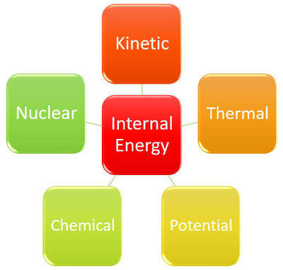
Internal energy is the sum of the energy possessed by the particles in an object or system.
Internal energy can include kinetic, potential, chemical, nuclear as well as thermal energy.

Slide 4
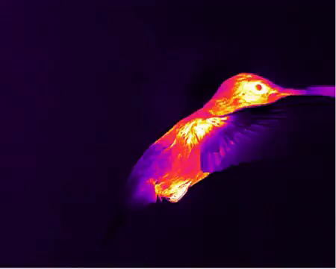
Thermal energy is a type of kinetic energy.
Kinetic energy refers to the energy of any object in motion.
Thermal energy is a type of internal energy. It is possessed by an object or system due to the movement of particles within the object or system.
Thermal energy can be transferred from one object or system to another as heat.

Slide 5

You may think that heat is the same as temperature.
It turns out that these are actually two different concepts.
Heat is a type of energy. It is the transfer of the thermal energy of particles from one object or system to another. It is measured in joules (J).
Temperature is the average kinetic energy of the particles in a substance. It is measured in degrees Celsius (∘C), degrees Fahrenheit (∘F) or Kelvin (K).

Slide 6
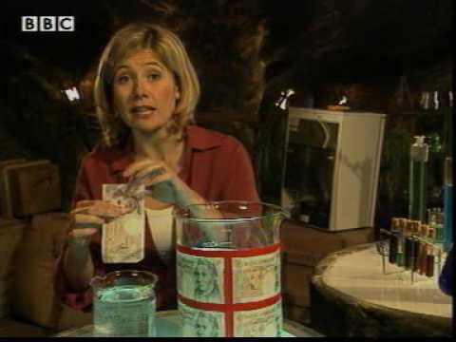

Slide 7

Consider a pot of boiling water. It has less thermal energy than a massive iceberg, even though it has a higher temperature.
This is because the iceberg has more particles in it than the boiling water. When you add the kinetic energy of all these particles together you get a larger number, and therefore more thermal energy.

Slide 8
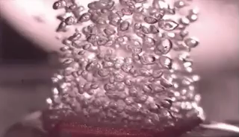
However, the average kinetic energy of the particles in the iceberg is less than the average kinetic energy of particles in the boiling water.
This means the iceberg is at a lower temperature than the boiling water.

Slide 9

Heat transfer is the movement of heat from one object to another object.
This heat always flows from the hotter object to the colder object.
This heat transfer is fastest when there is a large temperature difference.

Slide 10

There are three types of heat transfer:
Conduction.
Convection.
Radiation.

Slide 11

Conduction is the first method of heat transfer.
Conduction only occurs between two objects which are in direct contact. This means that the objects have to be touching.

Slide 12
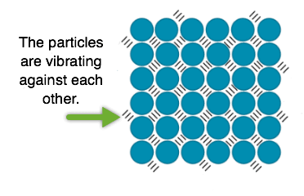
Conduction occurs because of particles vibrating within objects.
These particles are always vibrating. However, they vibrate faster in hotter objects.

Slide 13
When a hot object is in contact with a cold object, the quickly vibrating particles in the hot object will bump into the slower vibrating particles in the cold object.
This causes the particles in the cold object to vibrate faster, increasing the temperature of the object.

Slide 14

The second method of heat transfer is convection.
Objects do not need to be in contact for this type of heat transfer.
Convection occurs via fluids. Fluids is a term which includes both gases and liquids.

Slide 15
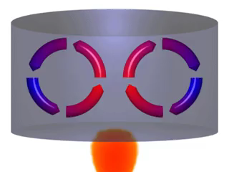
First, one part of the fluid is heated, causing the particles to move apart.
This makes this part of the fluid less dense than the surrounding fluid, causing it to rise.
Cool fluid moves into the space freed up by the less dense part of the fluid. This then gets heated and rises.

Slide 16
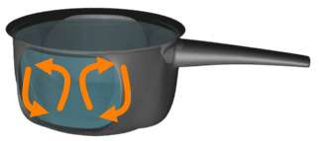
The heated fluid cools down as it moves away from the heat source.
This causes it to become more dense and sink again.
The fluid can then be heated again, continuing the cycle.
This movement of fluid is called a convection current.

Slide 17
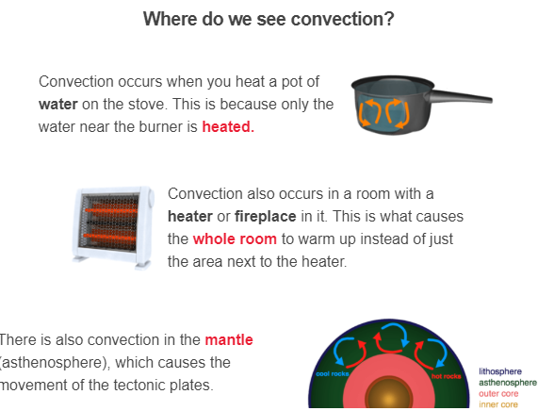

Slide 18

Radiation is the final method of heat transfer.
Every object radiates heat. This heat is transmitted as invisible waves which move at the speed of light!
Radiation transfers heat by waves, not particles like conduction or convection. This means that it can travel through the vacuum of space!
In physics terms, we say that radiation does not need to travel through a medium to transfer heat.

Slide 19
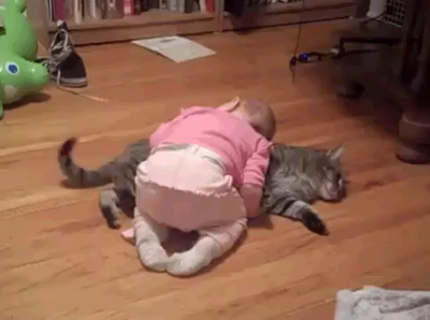
Every object radiates heat, even if we can't feel it.
You are radiating heat right now!
Hotter objects radiate more heat.
Some examples of objects which radiate heat are the Sun, a fire, your pet cat.... the list goes on and on!

Slide 20
